Slide 1

GRADED ASSESSMENT ON PYTHON
TOPIC : Case Study: Bank Telemarketing Campaign
PRESENTER :
AKASH BALAKRISHNAN

Slide 2

PREAMBLE
The bank aims to enhance its revenue by conducting a cost-efficient telemarketing campaign for term deposits among existing customers. Term deposits, fixed investments with predetermined interest rates, serve to foster long-term customer relationships. The objective is to conduct an end-to-end Exploratory Data Analysis (EDA)on the campaign dataset, identifying patterns and providing insights to improve the positive response rate. The analysis will involve examining customer demographics, temporal trends, and other factors influencing the success of the campaign, ultimately offering recommendations for targeted improvements in the bank's marketing strategy.
Case Study: Bank Telemarketing Campaign

Slide 3

Software/Tools:
● Jupyter Notebook(Python)
● Python

Slide 4
DATASETS :
bank_marketing_updated_v1.csv
Attribute details.xlsx

Slide 5

Conduct a thorough Exploratory Data Analysis (EDA) on the dataset related to the bank's telemarketing campaign that should involve the following sequential steps:
Task to Perform:

Slide 6
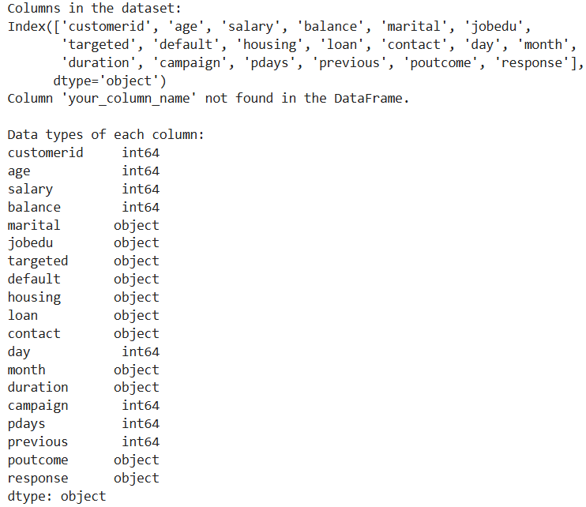
1. Understanding the Dataset
a. Load and scrutinize the dataset to comprehend its structure, encompassing columns and data types.
The different columns from the bank modelling dataset were showcased along with their datatypes.

Slide 7
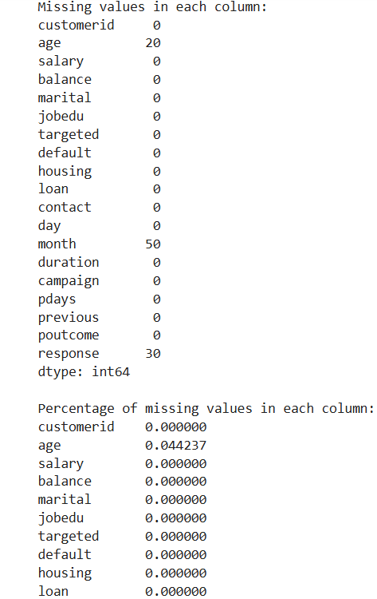
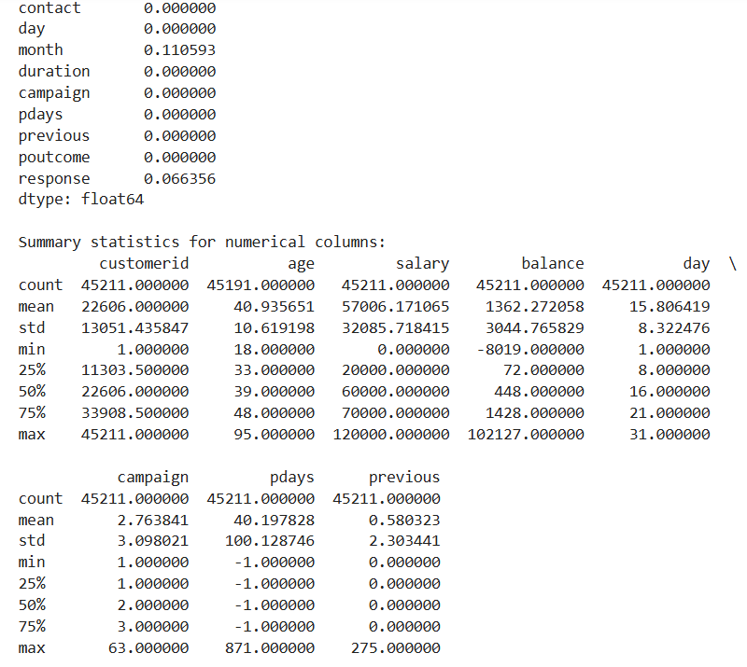
b. Inspect for any instances of missing values, outliers, or data inconsistencies.
Missing values in the columns :
Age – 20
Month -50
Response – 30
These missing values have to be filled in since they are important key factors.
Outliers :
The range of value between the max and min value for balance is 102,127 - (-8,019) = 110,146 whereas for campaign is 63 - 1 = 62.This indicates there are outliers in the data

Slide 8
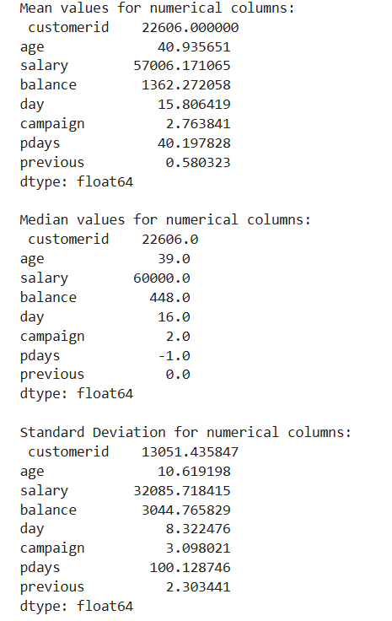
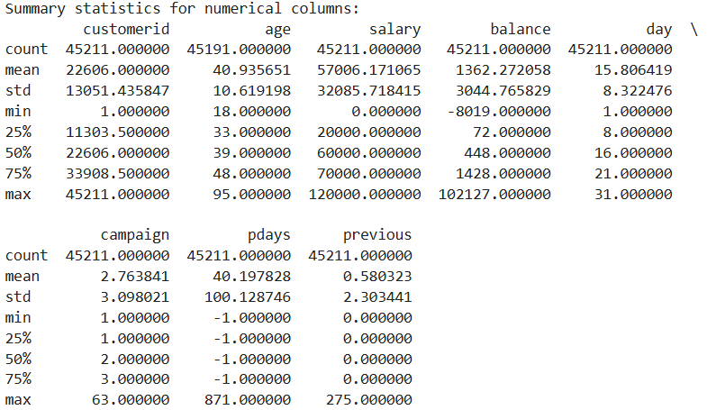
2. Descriptive Statistics a. Derive summary statistics (mean, median, standard deviation) for relevant columns.
The large variances and ranges in salary, balance, and the number of contacts indicate that the bank has a diverse customer base. This suggests the need for segmenting customers for more targeted marketing efforts.

Slide 9
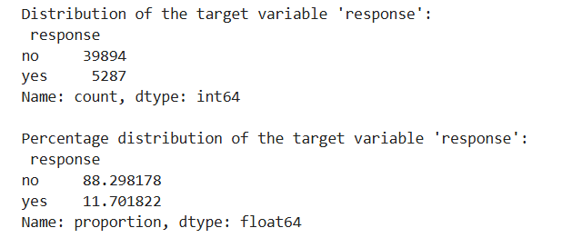
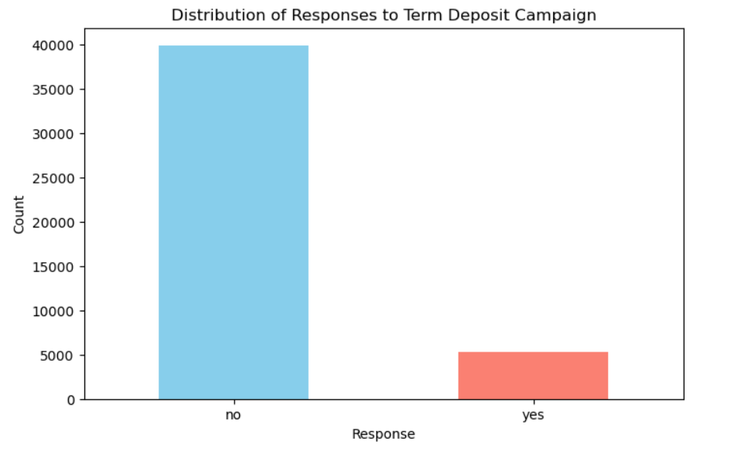
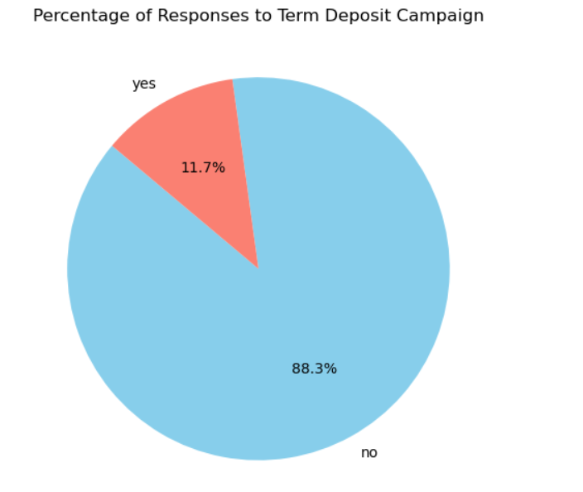
b. Examine the distribution of the target variable, indicating responses to the term deposit campaign.
The distribution of the target variable 'response' provides important insights into the effectiveness of the bank's marketing campaign.
The vast majority of customers (88.30%) did not respond positively to the campaign, while only a small fraction (11.70%) responded positively. Since a large percentage of customers are not responding positively, the bank might also consider strategies to re-engage these customers. This could involve follow-up offers, different communication channels, or even identifying and addressing potential reasons for their lack of response.

Slide 10
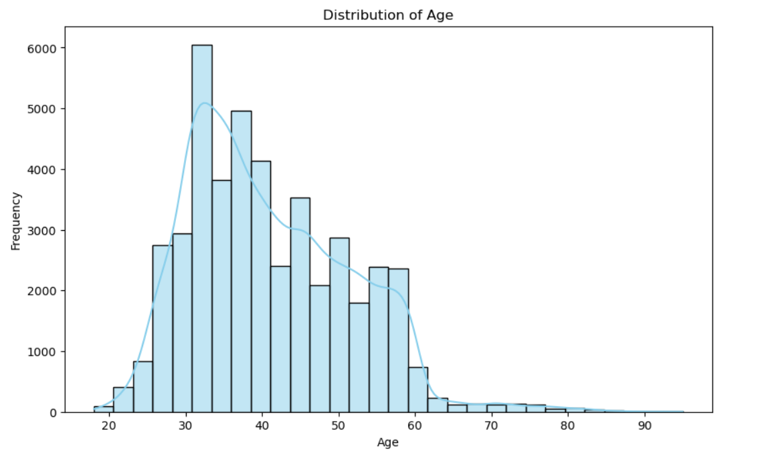
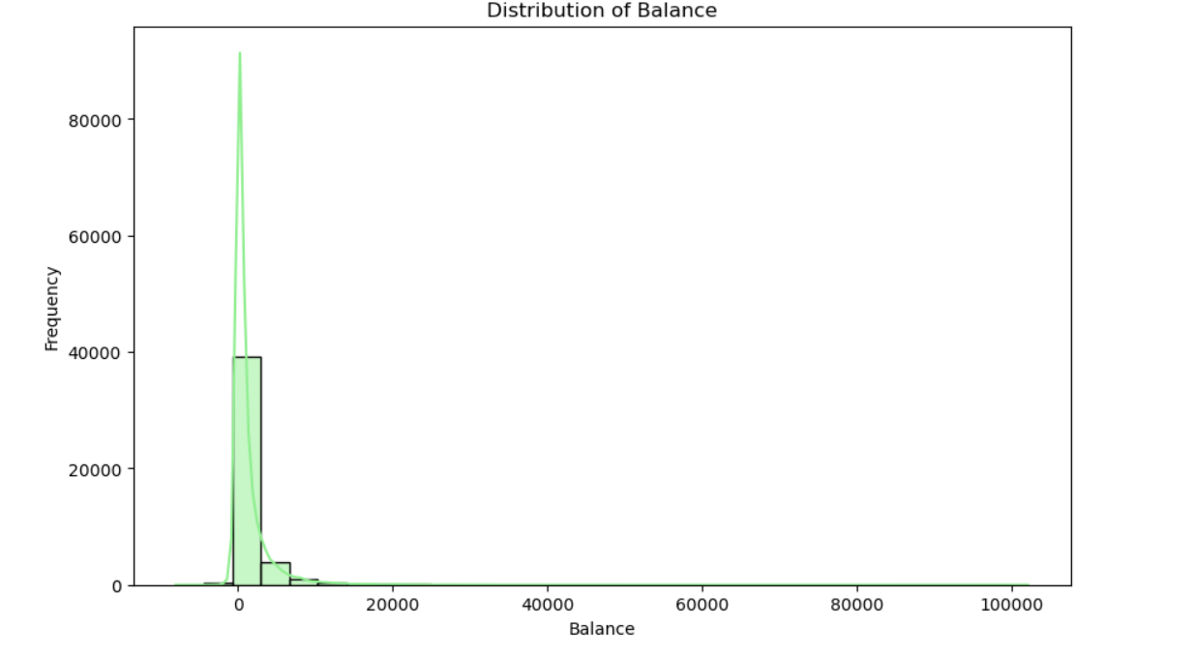
3. Univariate Analysis a. Examine the distribution of individual key features, such as age, balance, and call duration.
The distribution of balance is highly right-skewed, meaning that most customers have a low or negative balance, with a small number of customers having a very high balance. The age distribution appears somewhat normally distributed with a slight skew towards the younger population. The areas where the bank might consider tailoring its campaigns, such as focusing on the financial needs of the 30-50 age group and addressing the needs of customers with lower balances.

Slide 11
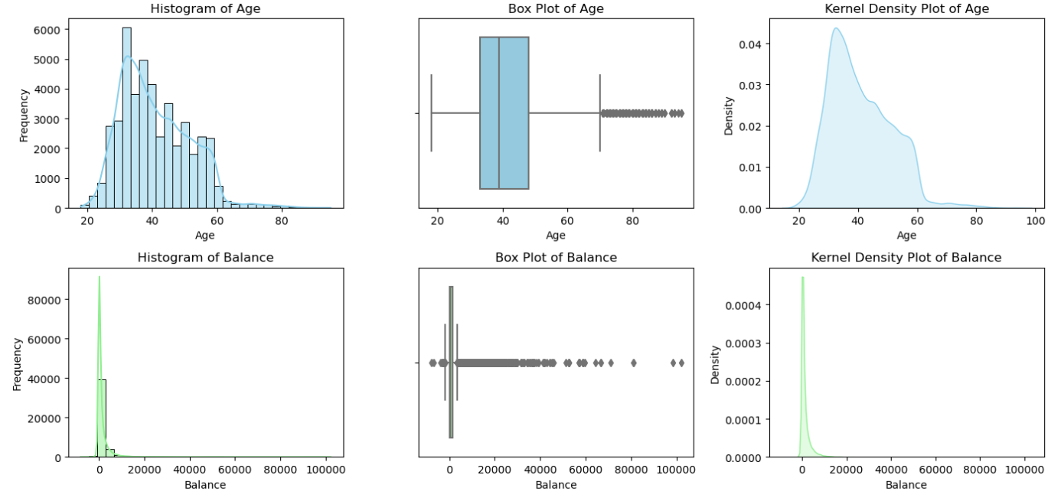
b. Employ visual aids like histograms, box plots, and kernel density plots to discern patterns and outliers.
The bank's main demographic seems to be individuals between 30 and 50, with fewer younger and older clients. The bank might want to focus its marketing efforts on retaining middle-aged clients while considering ways to appeal to younger or older demographics. The highly skewed distribution in balance suggests that most customers maintain small balances. The bank could create tailored products for customers with higher balances, while also addressing the needs of those with low or negative balances

Slide 12
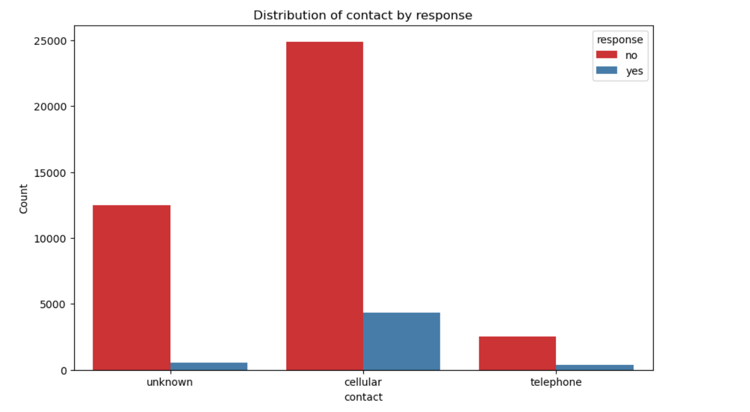
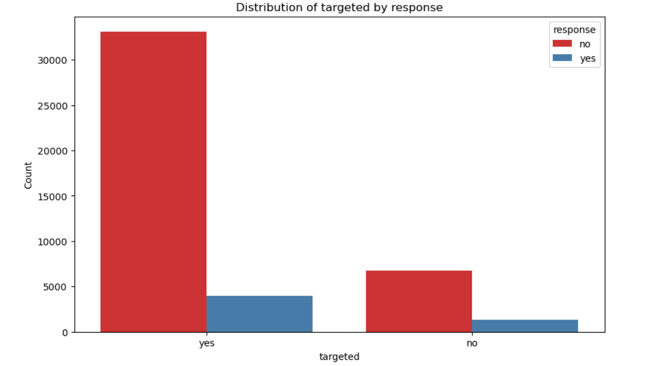
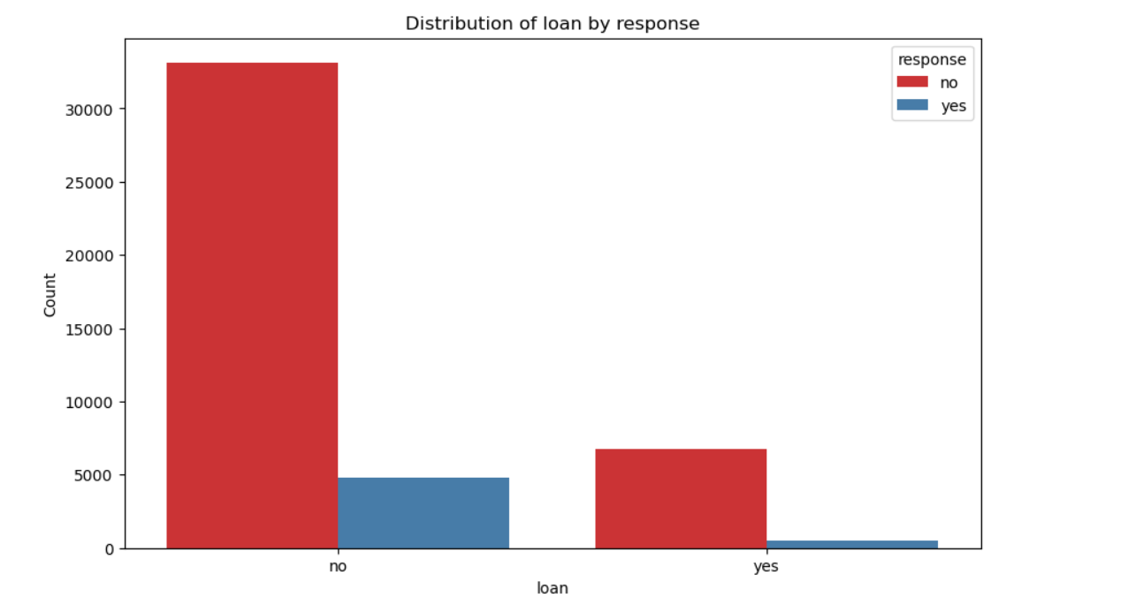
4. Bivariate Analysis a. Evaluate the relationship between independent variables and the target variable.

Slide 13
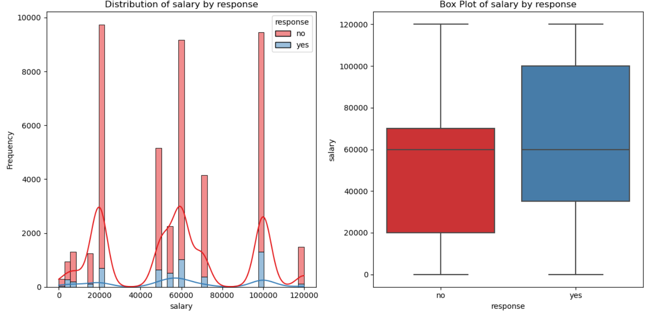
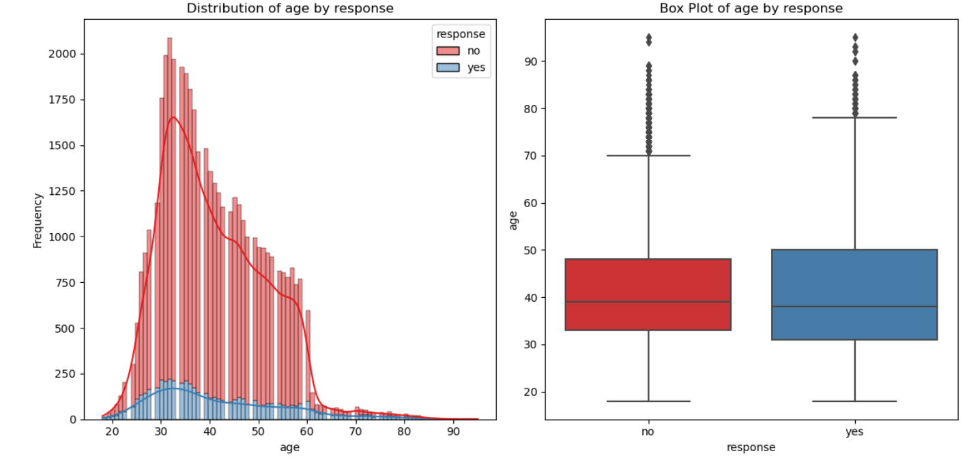
Higher salaries appear to correlate with a greater likelihood of responding positively to the campaign. Marketing efforts could focus on attracting higher-income individuals, as they seem more receptive to the offer.
Middle-aged customers (30–50) dominate both response groups, but there seems to be a slightly more diverse age range in the "yes" responses. This indicates that middle-aged customers are a crucial demographic for the campaign, and messaging might need to be adjusted to increase engagement among other age groups.

Slide 14
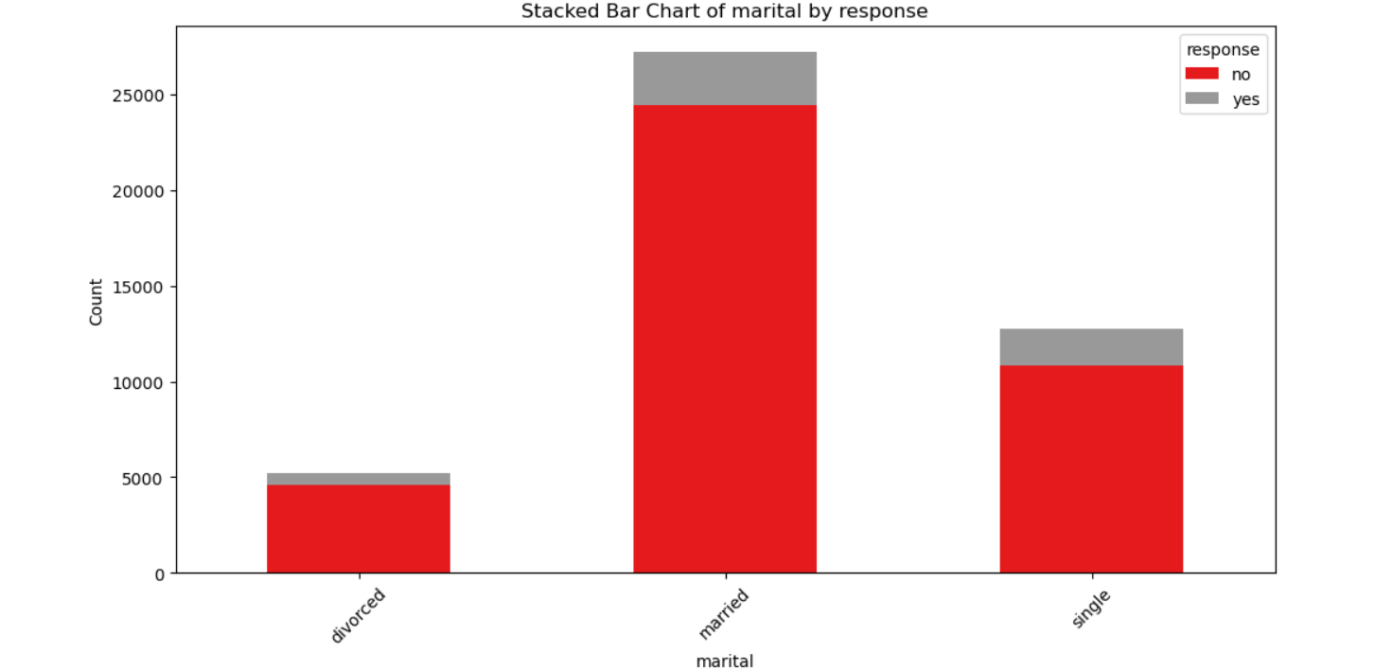
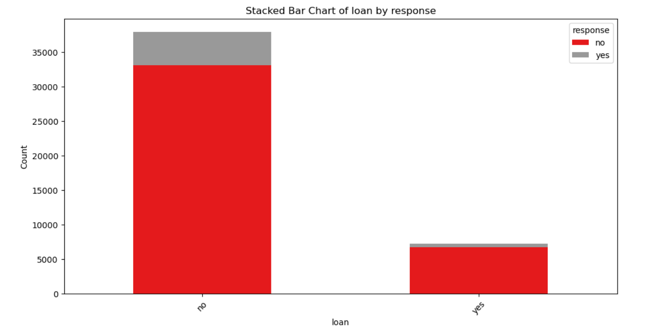
b. Analyze how features like age, job type, education, marital status, etc., associate with the success of the term deposit campaign, using visualizations like bar charts, stacked bar charts, and heat maps.
Middle-aged individuals (30-50) are more likely to subscribe, especially those with higher incomes and no loans.
Married individuals and those without loans are slightly more likely to subscribe.
Management professionals with higher education levels are among the most likely to subscribe. Similarly, blue-collar workers with tertiary education also show higher subscription rates.

Slide 15
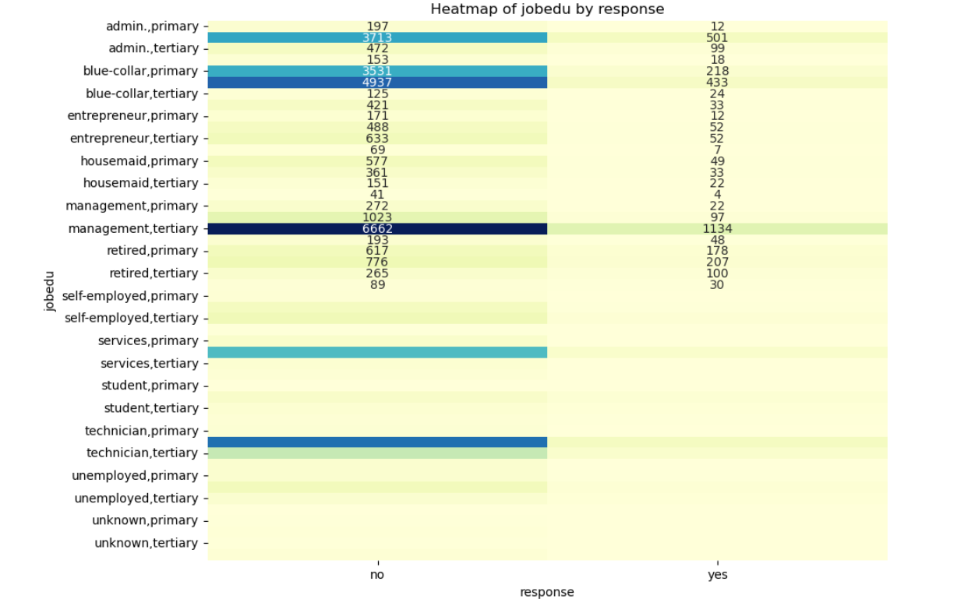
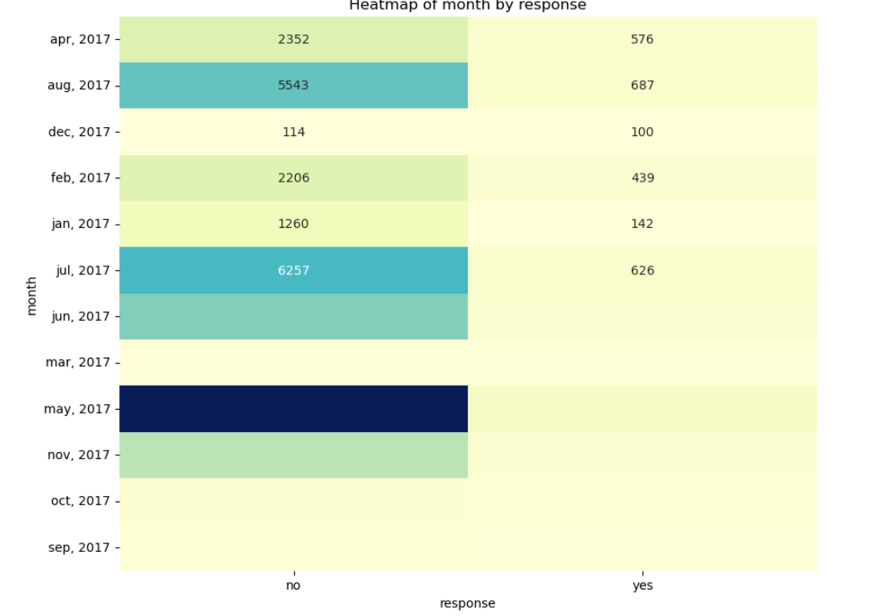

Slide 16
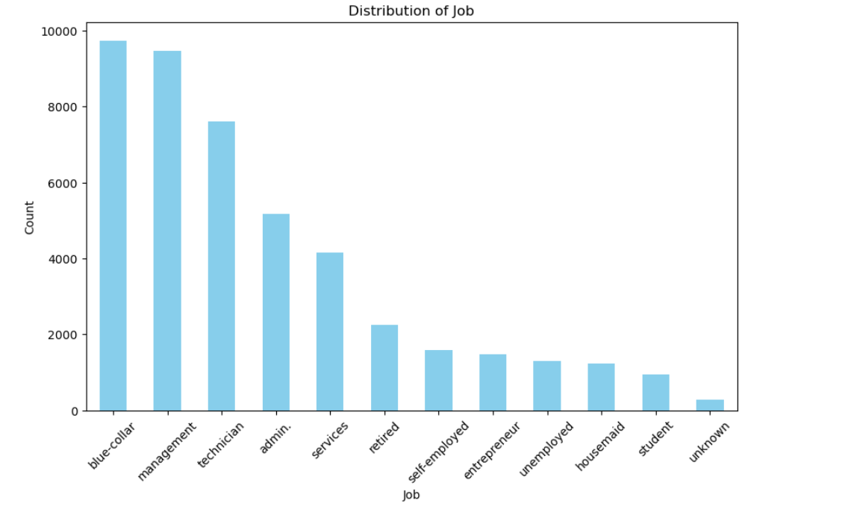
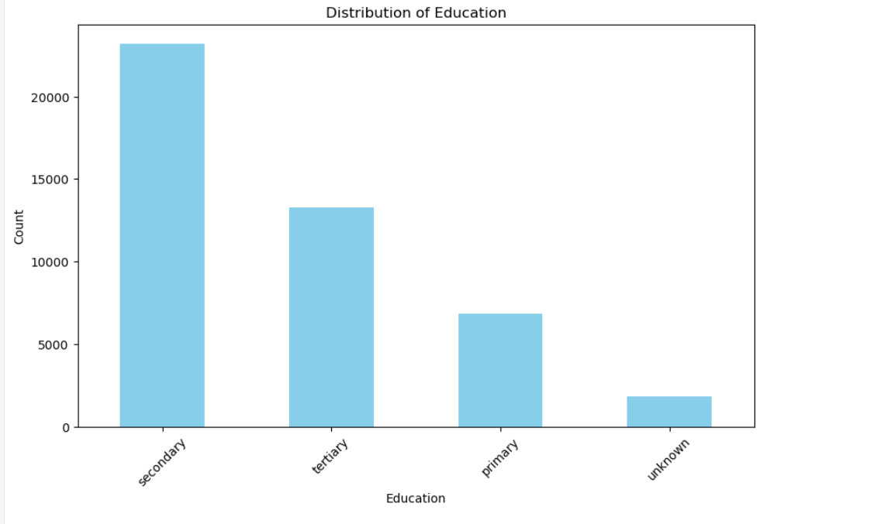
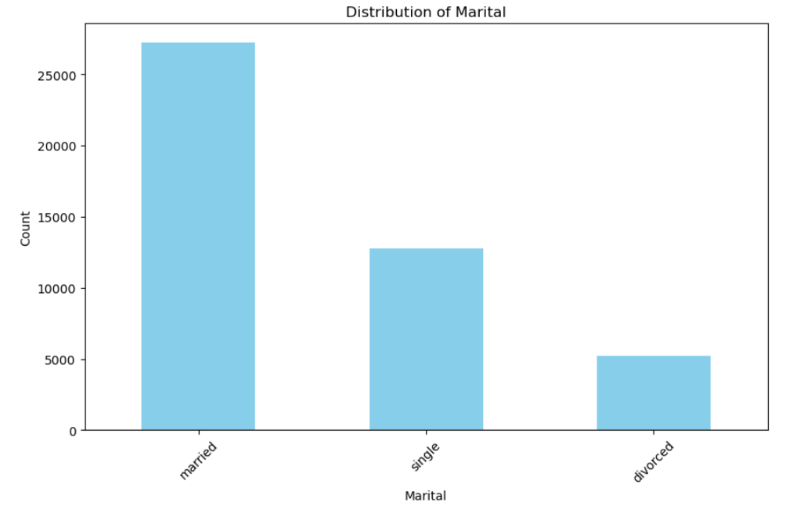
5. Categorical Variables Analysis a. Investigate the distribution of categorical variables such as job type, education, and marital status.

Slide 17
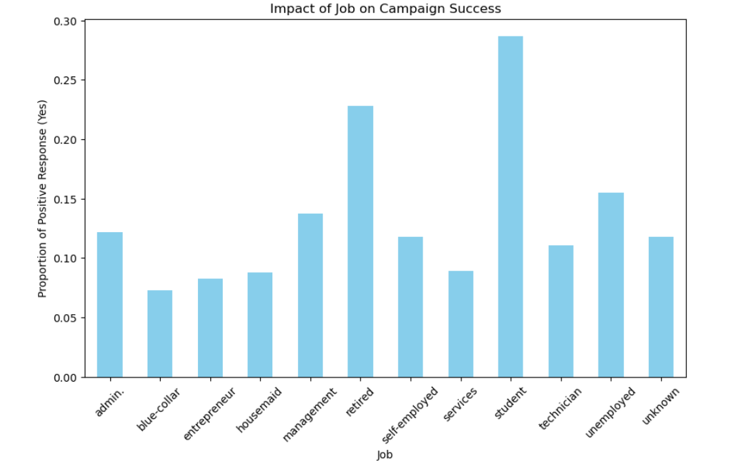
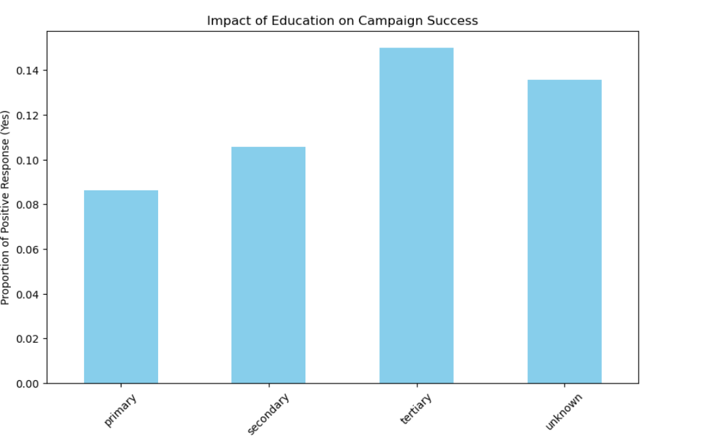
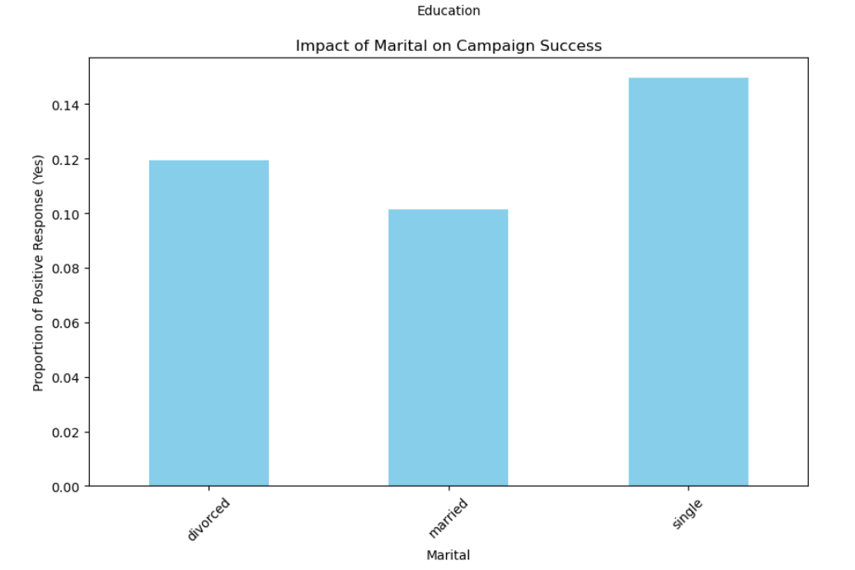
b. Assess the impact of these categorical variables on the campaign's success through visualizations like bar charts.

Slide 18
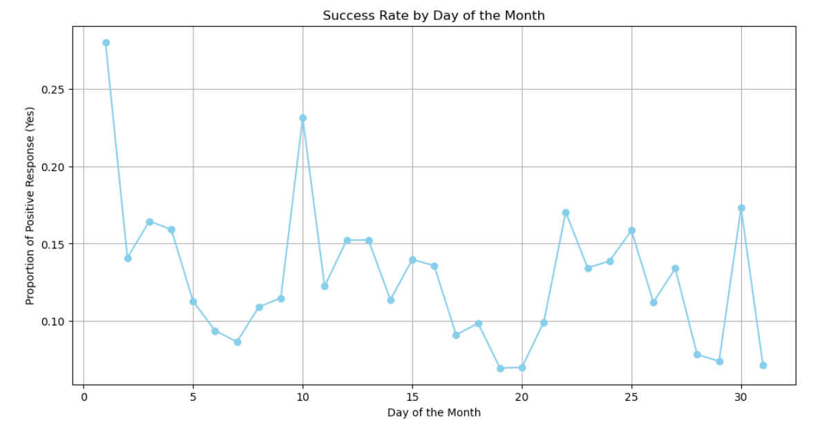
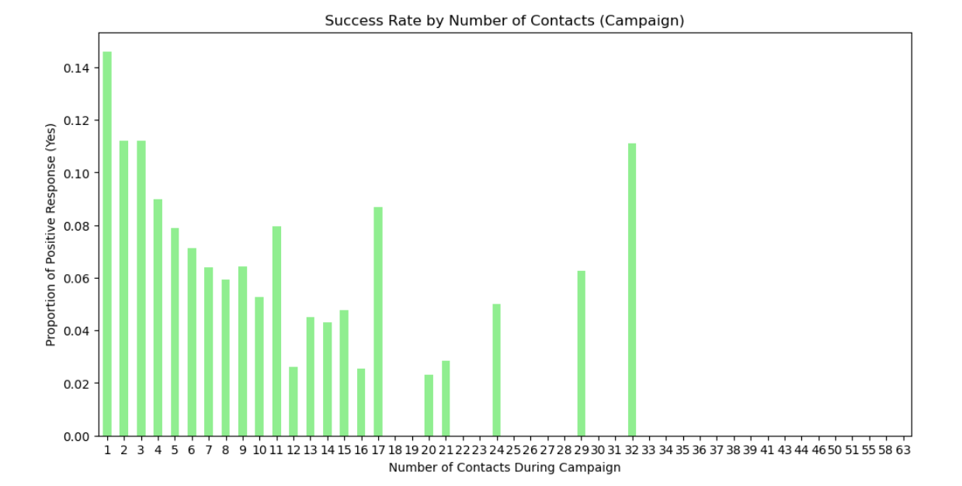
# 6. Temporal Analysis a. Investigate temporal patterns in the success of the campaign over time.

Slide 19
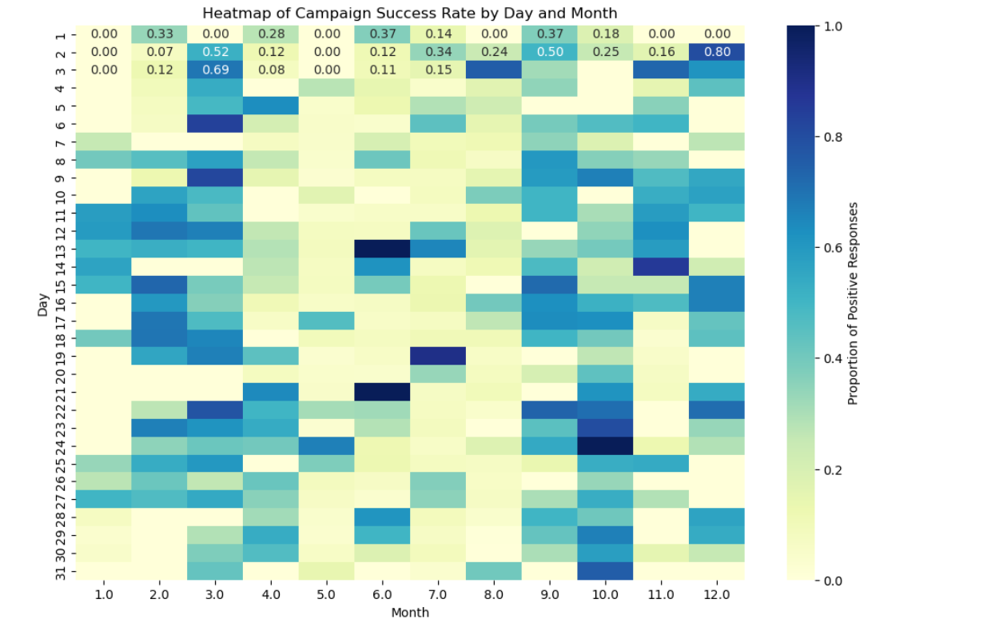
# b. Analyze if specific months or days exhibit superior campaign performance.

Slide 20


Thank You
AKASH BALAKRISHNAN

